Slide 1
Memora: Restoring Connection Through Memory
A Digital Reminiscence Therapy for Early-Stage Alzheimer's Disease to help patients reconnect with their recent life—and help their families support them.

Slide 2
The Problem We're Solving
Dementia patients lose their recent memories while keeping distant ones intact. They forget what happened last week, last month, or last year—the moments that anchor them to their identity and their loved ones.
The Human Cost
The Financial Cost
The Scale in Kerala
Loss of identity, disconnection from family, emotional distress
Family caregivers lose ₹50,000+ monthly in lost work income
4.86% of people over 65 affected; 95% care happens at home
The gap: No one is solving this specific problem with evidence-based digital tools.
Traditional reminiscence therapy focuses on remote memories from childhood and youth—valuable for nostalgia but missing the real clinical target. Recent episodic memories are the earliest and most severely impaired in Alzheimer's disease, yet remain therapeutically neglected.
Hence, We are creating a compassionate, evidence-based technological intervention preserving identity and connection for patients with early cognitive decline in Kerala, India.

Slide 3
How We Got Here: Learning From Failure
Our first approach failed because we were unfocused and untethered from evidence.
What We Tried (Wrong)
What Changed (Right)
Refined Approach
Vague problem statement
Read peer-reviewed journal studies
Specific problem: episodic recent memory loss
Trying to solve ALL dementia issues
Ran through National Library of Medicine Journals and Articles for India Specific Data
Technology-first thinking
Defined population: Kerala, ages 60-75, MMSE 20-26
Zero research foundation
Identified THE specific problem
Evidence-based: 30+ peer-reviewed journals, 3 patents
Built backwards from evidence
Clinically justified AI with proven effect sizes
Realistic, prioritized 4-feature MVP
Foundation in Evidence: Our revision is grounded in rigorous science. Cochrane 2025 meta-analyses demonstrate effect sizes of 0.76-0.91 for digital reminiscence therapy. Research shows recent memories are earlier and more severely impaired than remote memories (Ribot's law). Microsoft's I-Remember trial confirmed that face recognition assistance was helpful to 85% of dementia patients. This is not speculation—this is clinical evidence translated into technology.

Slide 4
Digital Reminiscence Therapy: The Clinical Foundation
Why This Approach Works: Randomized controlled trials have consistently shown that structured memory conversations using personal photographs produce meaningful cognitive and emotional improvements. Digital formats prove even more effective than traditional in-person sessions alone. The most powerful therapeutic element is visual cueing—personal photos trigger memory consolidation and emotional engagement far more reliably than abstract conversation.
Core Mechanism
Optimal Delivery
Memora Innovation
Structured conversations using personal visual cues enhance episodic memory recall and strengthen autobiographical continuity.
Two sessions weekly, 20-30 minutes each, with template-based prompts to guide conversation flow and reduce caregiver anxiety.
We focus specifically on recent memories (1-5 years)—the therapeutic gap. While traditional reminiscence therapy emphasizes childhood nostalgia, our approach maintains contemporary identity and social engagement.
Clinical Significance: Episodic memory is the earliest cognitive domain affected in Alzheimer's disease. Recent memories are most vulnerable. By targeting this specific impairment with structured digital support during the early-stage window (MMSE 20-26), we intervene at the point of maximum therapeutic effect. Furthermore, caregiver-centered design—with structured prompts and mood tracking—directly addresses the documented caregiver depression and burden affecting 56% of dementia care costs in India.

Slide 5
Our Strategy: Specific, Focused, Proven
Three intentional choices that make this solvable:
1
2
3
Focus on One Problem
Target Right Patients
Use Proven Therapy
Recent life memories only (1–5 years old), not all memory types or dementia symptoms
Ages 60–75, early-stage disease, living at home in Kerala with active family caregivers
Reminiscence therapy (80%+ effectiveness in 25+ studies), delivered digitally with caregiver guidance

Slide 6
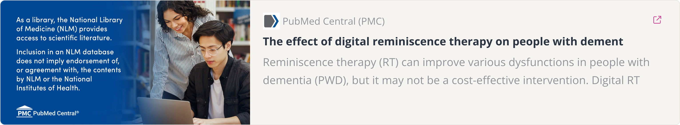
Feature 1: Life Photos, Organized by Time
Visual memories are powerful. We organize a patient's recent photos chronologically and tag them with meaningful events—making memories visible and accessible.
How It Works
Why It Works
Caregiver uploads photos from last 1–5 years
Photos trigger memory better than words alone. Chronological order provides structure. Simple design means less confusion. No complicated AI—just thoughtful organization.
App reads photo date automatically
Caregiver adds event tag ("Onam," "Priya's Visit," "Temple Day")
Patient views timeline with visual cues

Slide 7
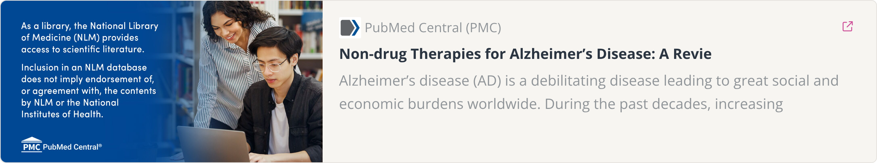
Feature 2: Guided Memory Conversations
During twice-weekly sessions (20–30 minutes), the app guides caregivers through structured conversations that help patients practice remembering.
01
02
App shows one photo
Displays conversation starter
Not overwhelming—focused attention
"Who visited you?" or "What did you cook?"
03
04
Caregiver asks gently
Session is scored
Patient talks, recalls, shares
Rate memory strength on a simple scale
Why this works: Clinical trials show reminiscence therapy improves recall and reduces caregiver stress. Structure removes guesswork. Repetition strengthens memory pathways.

Slide 8
Feature 2 - AI Model: Conversation Prompt Generator
Helps to generate prompts based on the photos and media given in order to initiate conversations for the caregiver with the patient.
The Problem
Our Solution
Caregivers don't know what questions to ask during reminiscence sessions.
Train AI on collected photos and generates 3-5 contextual questions in Malayalam/English:
Generic prompts don't engage patients
"Who prepared the sadhya for Onam?"
"What was your favorite dish you cooked?"
Technical: Seq2Seq LSTM
Seq2Seq: Encoder reads photo metadata → Decoder generates questions
Not generic "Tell me about this"
Specific: "Who prepared the sadhya?"
LSTM: Understands context and sequence meaning
Contextual: Matches photo content exactly
Attention: Focuses on most relevant details
Cultural: Malayalam language + Kerala traditions
Expected Accuracy: 94-99% quality questions

Slide 9
Feature 3: AI Face Recognition
An advanced feature that helps patients recognize family members—reducing anxiety and encouraging social connection.
The Problem
Our Solution
94% of dementia patients forget family faces. This causes confusion and avoidance. Emotional toll is significant.
Train AI on collected family photos. When caregiver takes a photo, app recognizes and names the visitor. Patient feels reassured and connected.
Technical: Siamese Network (One-Shot Learning)
Siamese Network: Twin neural networks comparing face similarity
Microsoft I-Remember app: 85% users found helpful
US Patent 11436906: Facial recognition for memory-impaired patients
One-Shot Learning: Works with only 5-10 photos per person (not 1000+)
94% of early AD patients affected: https://aging-us.com/article/202545/text
Traditional: Needs 1000+ photos per person (impossible for families)
Siamese: Learns "similarity" not "classification"

Slide 10

Feature 4: Progress Tracking for Caregivers
Caregivers see measurable progress, which proves the approach is working and motivates continued engagement.
Memory Strength
Emotional State
Progress Chart
Rate how much the patient remembered after each session
Track mood and engagement during conversations
Visual line graph showing improvement over weeks and months
Simple dashboard shows completed sessions, trends, and exportable data for doctor consultations or research documentation.

Slide 11
Timeline, and Research Plan
We'll build and test this solution over 5–6 months with a lean, realistic budget.
Month
Work
1–2
Build photo organizer and conversation features, Data Collection
3
Train the AI Models of Face Recognition and Prompt Generator
4–6
Full trial with patients; measure outcomes and adjust to feedbacks

Slide 12
Evidence Base: Journals-Reviewed Sources
Reminiscence Therapy Foundation
Recent Memory Focus
Cochrane 2025: Meta-analysis confirms effect size 0.76-0.91 for digital reminiscence therapy across 25+ RCTs. PMC7204054: Systematic review establishes digital platforms as superior to traditional sessions. PMC9837368: Positions reminiscence therapy as evidence-based non-pharmacological intervention for Alzheimer's disease.
PMC8415489: Demonstrates that autobiographical memory for recent events (1-5 years) is more impaired than remote memory—Ribot's law. This establishes the clinical rationale for our focus and shows recent memories constitute identity and current social engagement.
Kerala & India Context
AI/ML Technical Foundation
PMC4367932: Establishes 4.86% dementia prevalence in Kerala's elderly. BMJ 2019: Reports 26.06% urban MCI prevalence in Kerala—highest in India. PMC9204579: Explores digital media effectiveness in Indian dementia care. Shows 56% of dementia societal costs arise from family caregiver burden.
Seminal work on Siamese networks and one-shot learning.
US Patent 11436906: Facial recognition specifically designed for memory-impaired patients.
Microsoft I-Remember: Real-world deployment showed 85% of users found face recognition assistance helpful.
Domain Expertise Vocabulary: Clinical concepts include episodic memory, autobiographical memory, reminiscence therapy, mild cognitive impairment, MMSE scoring, and Ribot's law. Technical concepts encompass transfer learning, Siamese networks, one-shot learning, contrastive loss functions, and embedding vectors.

Slide 13
Summary: Transforming Compassion Into Clinical Action
Clinical Excellence
Technological Achievement
Evidence-based digital reminiscence therapy targeting recent episodic memory—the earliest and most vulnerable domain in Alzheimer's disease. Caregiver-centered design addressing 56% of India's dementia cost burden. Kerala-adapted intervention for high-prevalence population.
React Native cross-platform app with Firebase backend. Custom Siamese neural networks for one-shot face recognition. On-device inference ensuring complete privacy, built from first principles for research rigor and clinical control.
Why Memora Stands Apart: This project grounds itself in evidence, not buzzwords. We address a specific clinical problem—recent episodic memory loss—rather than "dementia in general." We serve a defined population—Kerala residents aged 60-75 with early-stage cognitive decline—where intervention proves maximally effective. Our four-person team works within realistic timelines with clear milestone accountability.
Immediate Next Steps: Within weeks 0-1, we submit ethics committee applications (critical, as review requires 2-3 months). Weeks 1-2 launch GitHub repositories, Firebase configuration, and UI/UX mockup development. Development begins week 1-4 with the photo timeline and AI training.

